Slide 1


Path Finding & Nevigation System
Smart solution of finding path
1

Slide 2
Present by:
Rukonuzzaman Topu
Student ID- 232002280
Department of CSE
Green University of Bangladesh
2

Slide 3
Project Goals
Develop a pathfinding algorithm that can efficiently navigate through crowded and dynamic environments.
Minimize delivery time while ensuring safety and avoiding obstacles.
Reduce dependence on human intervention for route planning.
3

Slide 4
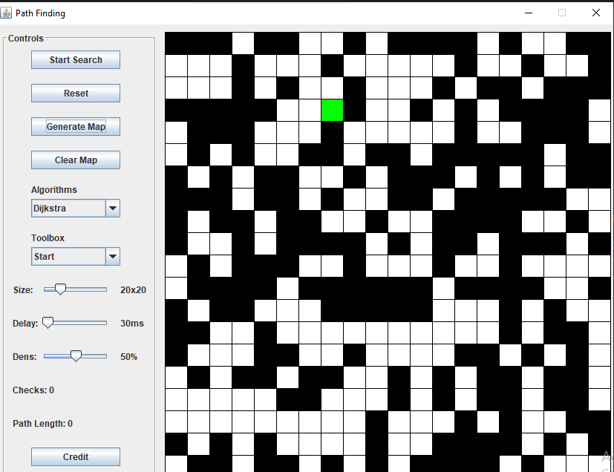
Features
4

Slide 5
User Control and Customization
Choice between two pathfinding algorithms: Dijkstra's and A*.(add other 2 algorithms)
Adjustable grid size and obstacle density.
Interactive placement of start and finish points and drawing of obstacles.
Control panel with sliders and buttons for easy manipulation.
5

Slide 6
Thank you
6

